Slide 1
ATLIQ SALES INSIGHTS
Power BI Quick Insights

Slide 2
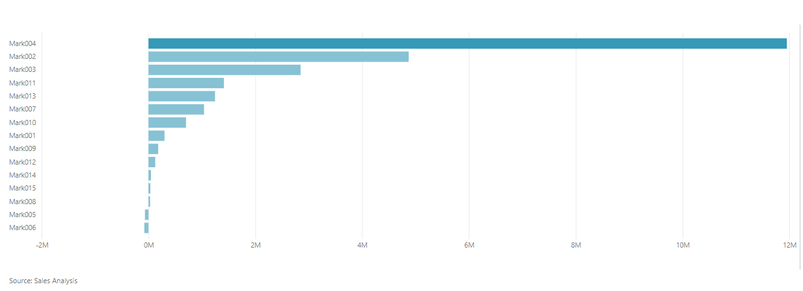
Profit Margin by Market Code
Mark 004 has the highest profit margin as per the year 2020.

Slide 3
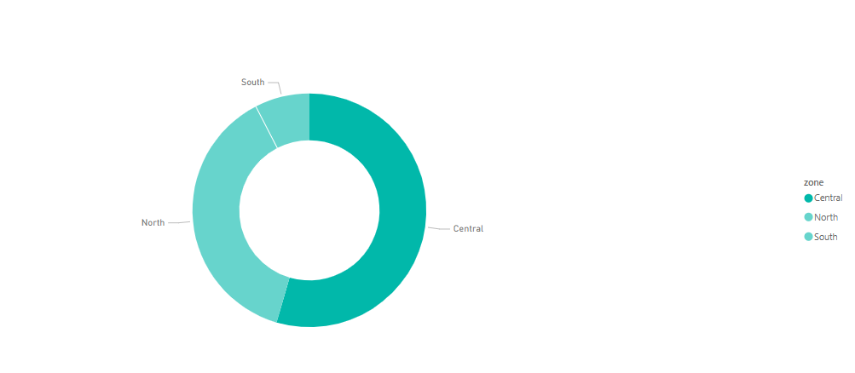
Count of Customer Sales by Zone

Slide 4
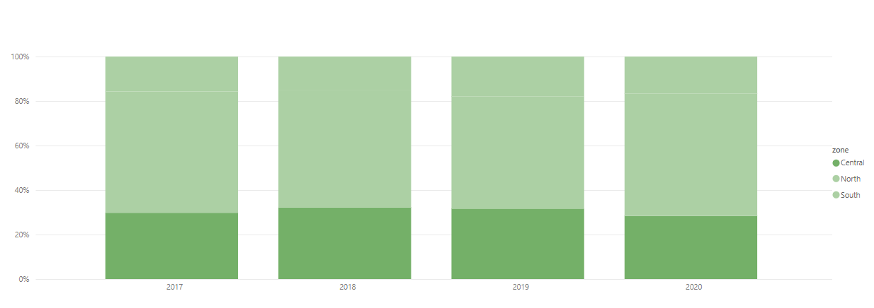
Sales Quantity by year & zone

Slide 5
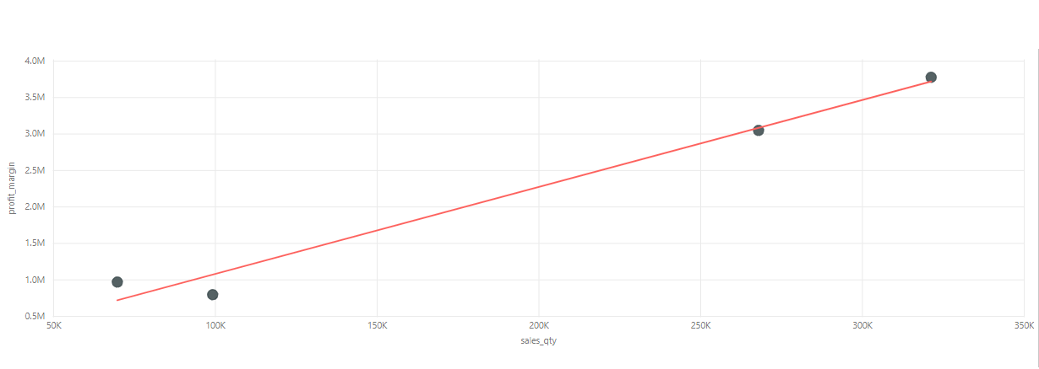
Sales Quantity versus Plot Margin by year

Slide 6
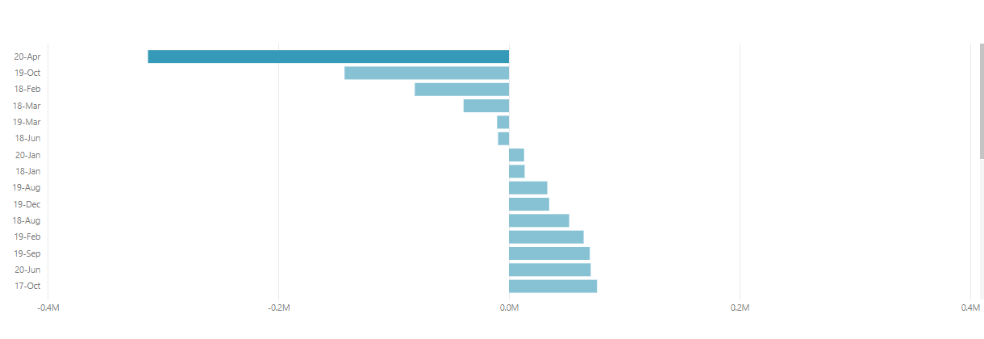
Plot Margin by date
20th April has a notably less profit margin.

Slide 7
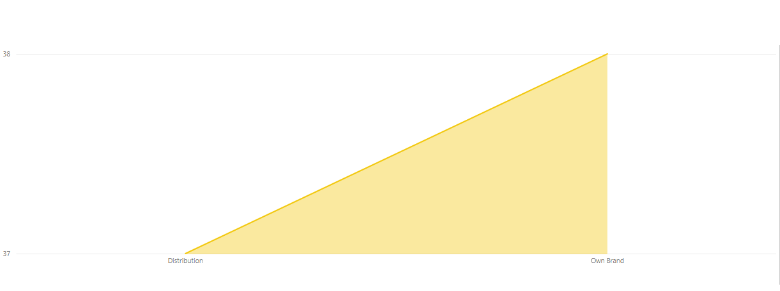
Count of Customer Sales by Product Type
There is relatively even sales customers by product_type for year 2019.

Slide 8
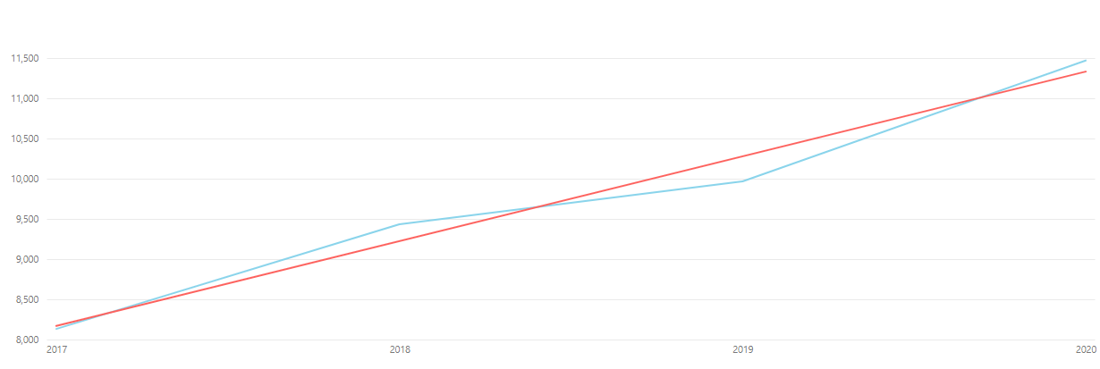
Average Cost of price per year
cost_price is trending upwards for zone 'North'.

Slide 9
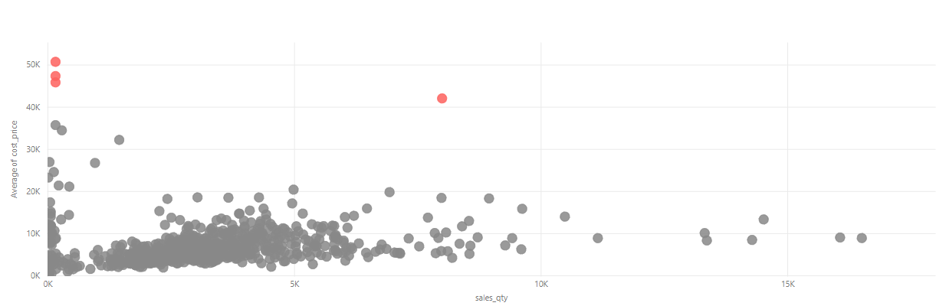
Scatter Plot for Sales Quantity versus Average Cost price
sales_qty and cost_price have outliers for date Saturday, August 24, 2019, Saturday, November 23, 2019, Saturday, February 29, 2020 .

Slide 10
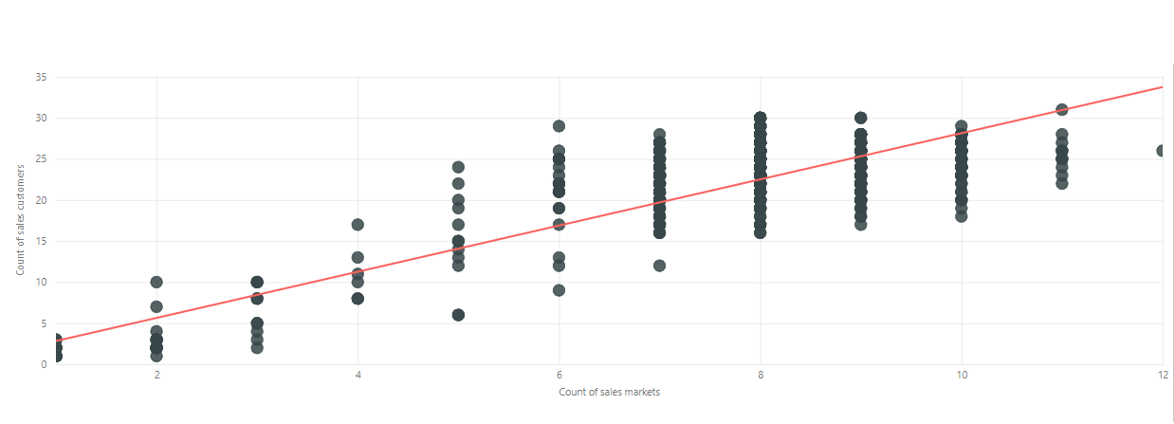
Count of sales markets, COunt of sales customer by year
There is a positive correlation between sales markets and sales customers.

